Slide 1
An Overview
of Computing
&
Career Planning
UNIVERSITY INSTITUTE OF ENGINEERING
Bachelor of Engineering -Computer Science & Engineering
Web Programming using .NET
20CST-381
Design By:
Prof. Harmanjeet Singh
Wipro Certified, EPAM Certified

Slide 2
SYLLABUS
20CST-381 |  | WEB PROGRAMMING USING .NET |  | L | T | P
 |  | Total Contact Hours: 30 |  | 2 | - | -
 |  | Applicable to which branch: BE
 |  | Prerequisite : Basics of Programming
Marks
Internal :40 |  |  | External:60
Course Objective
1. Student will acquire knowledge on the usage of .NET platform in developing web applications 2. Student will develop skills in analyzing the usability of a web site. 3. Student will understand how to plan and conduct user research related to web usability
S. No. | Course Outcomes
CO1 | Apply .NET framework and its components to design applications
CO2 | Analyzing the methods and ways used for creating a Web form with server controls.
CO3 | Outline errors and exception configuration for web debugging in line with dynamic environment
CO4 | Illustrate ADO.NET techniques for data retrieval from database engine on visual studio.
CO5 | Develop dynamic program environment using session management and user’s preference support.
CO6 | Create and use classes of System.xml namespace for experimenting the operations on XML files.

Slide 3
SYLLABUS
UNIT-I
Overview of .NET Framework
OOPS: Object, Class, Abstraction, Encapsulation, Polymorphism, Inheritance, Overloading and Overriding.
.NET Framework Introduction
Overview, Framework Components, Framework Versions, Types of Applications which can be developed using MS.NET,MS.NET Base Class Library, MS .NET Namespaces ,MSIL / Metadata and PE files, The Common Language Runtime (CLR), Managed Code ,MS.NET Memory Management / Garbage Collection, Common Type System (CTS) ,Common Language Specification (CLS) ,Types of JIT Compilers, Security Manager. VS.NET and C, Introduction to Project and Solution in Studio, Command Line Arguments, Global, Stack and Heap Memory, Reference Type and Value Type, Boxing and Unboxing, Pass by value and by reference and out parameter, Array Lists & Hash Tables, Generic Collections.
GAC and its Generations
Assemblies, Private & Global Assemblies, Installation in GAC

Slide 4
SYLLABUS
UNIT-I
Generics, LINQ and Lambda
Collections and Generics
LINQ-to-objects queries: Fluent syntax and Query operators
Lambda expressions and function signatures: Query Expressions, Supporting Query Expressions, Deferred Evaluation, LINQ, Generics, and IQueryable<T>.
Standard LINQ Operators: Filtering, Select, SelectMany, Ordering, Specific Items and Subranges. Set Operations. Joins.
Local Queries.
Interpreted Queries (IQueryable preview).
Combining Interpreted and Local Queries.

Slide 5
SYLLABUS
UNIT-I
Reflection, Serialization
Serialization Concepts, Serialization mechanisms in the .NET Framework, Formatters, The Data Contract Serializer, The Binary Serializer ,XML Serialization.
TPL, Asynchronous Programming & Threading
Pros and Cons of Threads, The Task Parallel Library, Task Parallelism, Data Parallelism.
Events, Delegates

Slide 6
SYLLABUS
UNIT-II
ASP.NET MVC/Web Forms/Win Forms
Windows Forms and Controls and MDI Applications
Page Life Cycle, Event Handling, Server Side vs Client Side, Themes, Skins, Master Pages, Directives, Validators, Regular Expressions, Server Controls and User Controls, State Management(Cookies, Sessions, ViewState), HTTP Handler / HTTP Module, Security, Caching, Localization, Configuration and Deployment, MVC Architecture, Razor Engine, Controllers, Views, Models, Layout, Routing Engine, Action Filters, Bundling, Exception Handling
.NET Core/Entity Framework/Dapper
Application startup, middleware, Configurations, Authentication, Swagger, Logging, Exception handling, Routing, Attribute routing, TagHelpers, Filters, CORS, CSRF, Razor, Caching, Compression. ORM, Unit of work Design pattern, Repository Design pattern & CQRS, EF components( DbContext, Change tracker, DbSet, Entities, Database), Code First Approach, DB First Approach, Data Annotations, Dapper, Dapper annotations, Unit testing, MOQ, mock and stub.

Slide 7
SYLLABUS
UNIT-II
Web API/REST/WCF/Web Services
Restful Services - Basics (Http actions and codes, rest principles),Web API controllers , Basic and Attribute routing, Versioning, Web API - Authentication, Authorization, Exception Handling. Web API: model validation, dependency injection, Caching, WCF: Address/Binding/Contract and Hosting, diagnostics, exception handling, Service Fundamentals. Data Contracts, Serialization, Messages, Configuration (Code vs Declarative vs Configuration), Security, Extensibility

Slide 8
SYLLABUS
UNIT-III
Tools/Courses/Process
Repositories: TFS, SVN, GIT, JIRA, AzureDevOps - Boards, VersionOne, Rally, CI/CD: Jenkins, Bamboo, GITLab, DevOps - Release & Pipeline, EngX BootCamp, Clean Code Self/Mentor Based, Clean Design, Practice Onboarding, SDLC - Methodologies - Agile (Scrum/Kanban), Waterfall, Code Review: Cruisible, GIT Pull Request, Static code analyis, SonarQube, Rules, Resharper, code coverage tools
Client Side Technologies
JavaScript: Fundamentals, Step to Prepare First Example in JavaScript, Variables, Operators, Control Statements, Functions, Arrays, Object Oriented Programming in JavaScript, Clousers, Hoisting, DOM, JQuery, Javascript Frameworks Introduction (Angular/React)

Slide 9
SYLLABUS
UNIT-III
Front-end Technologies
HTML CSS: "Understanding HTML Syntax, DOCTYPE, Basic Tags in HTML, Tags, Forms, Storage, Geo Location, Canvas, SVG", Types of Stylesheets , Types of Selectors , Div’s & Span tags, Font , Text, INTRODUCTION TO CSS-3.0, Nested Classes, Responsive Design (Bootstrap)“
Database: Introduction to Basic Database Concepts, E-R Modeling and Diagram, Normalization, Introduction to SQL Server, Introduction to SQL, DDL and DML Statements, Aggregate Functions, Joins and Set Operations, Implementation of Data integrity, Working with Constraints, Implementing Views, Data Control language (DCL), Working with Indexes, Working with Stored Procedures and Functions, Implementing Triggers, Working with Cursors, Backup and Restore and No SQL Introduction

Slide 10
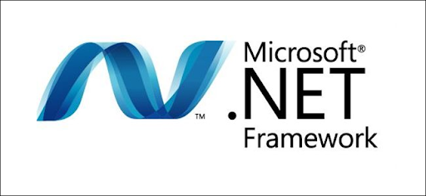
.NET Framework
FIGURE 1.1(.Net Framework)[1]

Slide 11
.NET Framework
The .NET Framework is a new and revolutionary platform created by Microsoft for developing applications
It is a platform for application developers
It is a Framework that supports Multiple Language and Cross language integration.
It has IDE (Integrated Development Environment).
Framework is a set of utilities or can say building blocks of your application system.
.NET Framework provides GUI in a GUI manner.
.NET is a platform independent but with help of Mono Compilation System (MCS). MCS is a middle level interface.
.NET Framework provides interoperability between languages i.e. Common Type System (CTS) .
.NET Framework also includes the .NET Common Language Runtime (CLR), which is responsible for maintaining the execution of all applications developed using the .NET library.
The .NET Framework consists primarily of a gigantic library of code.

Slide 12
Cross language integration
.NET Framework includes no restriction on the type of applications that are possible. The .NET Framework allows the creation of Windows applications, Web applications, Web services, and lot more.
The .NET Framework has been designed so that it can be used from any language, including C#, C++, Visual Basic, JScript, and even older languages such as COBOL.

Slide 13
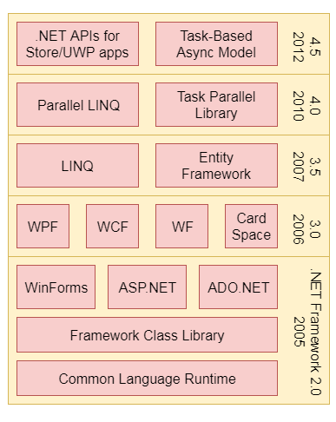
.NET Framework components
Common Language Run Time
Framework Class Library (FCL)
Core Languages
Other Modules

Slide 14
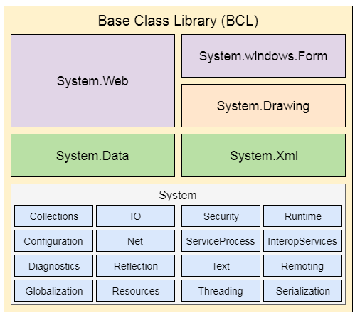
.NET Framework components
Framework Class Library (FCL)

Slide 15
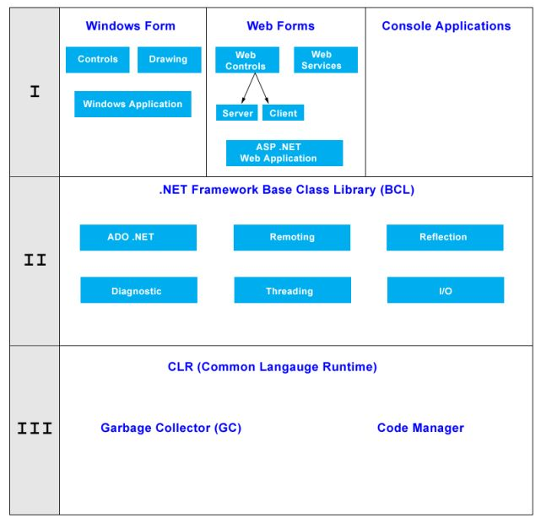
Architecture of .NET Framework
Common Language Run Time
Base Class Class Library (BCL)
Windows Forms
Web Forms
Console Applications

Slide 16
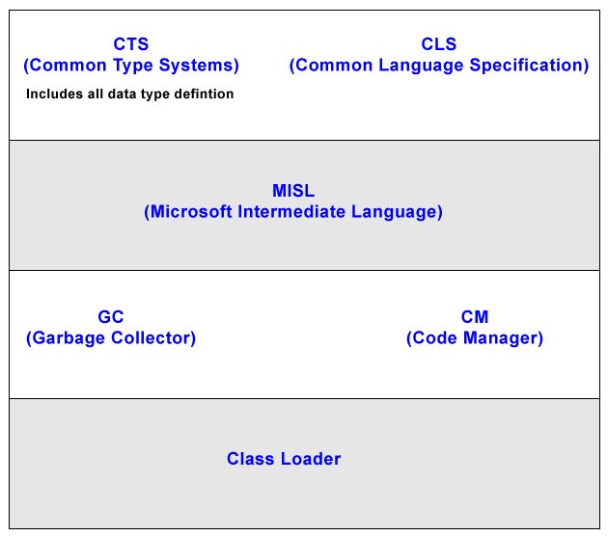
Common Language Run Time(CLR)
CLS (Common Language Specification)
Code Manager
Managed Code
Un-Managed Code

Slide 17
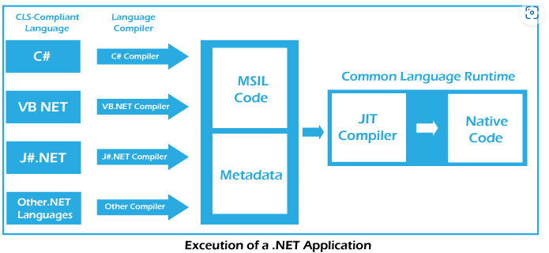
Components of Common Language Run Time(CLR)
CTS
CLS
GC
JIT
Metadata
Assemblies

Slide 18
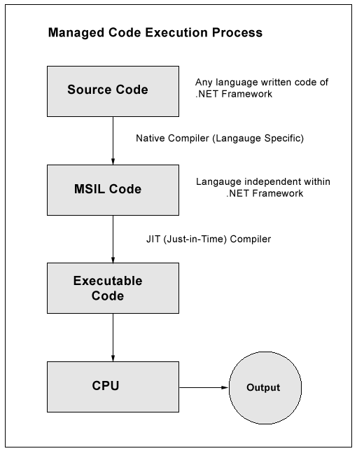
Common Language Run Time(CLR)
Managed Code

Slide 19
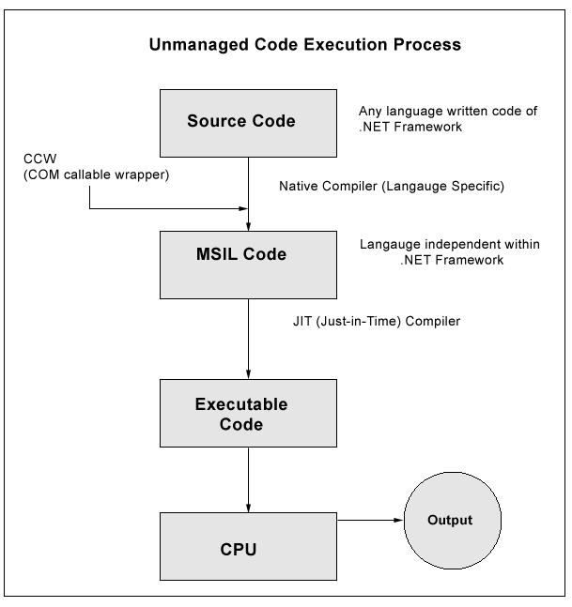
Common Language Run Time(CLR)
Un-Managed Code-CCW

Slide 20
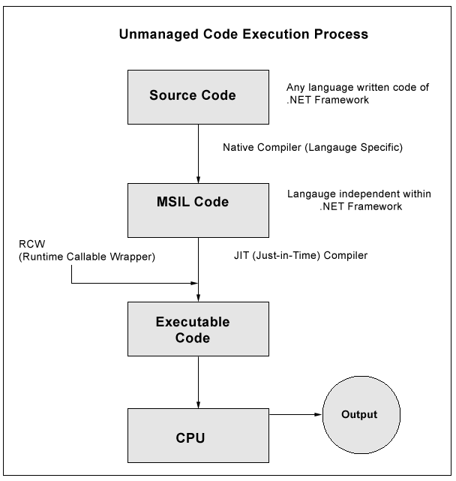
Common Language Run Time(CLR)
Un-Managed Code-RCW

Slide 21
Common Language Run Time(CLR)
Native Code
MSIL
JIT
Pre JIT
Econo JIT
Normal JIT
Assemblies

Slide 22
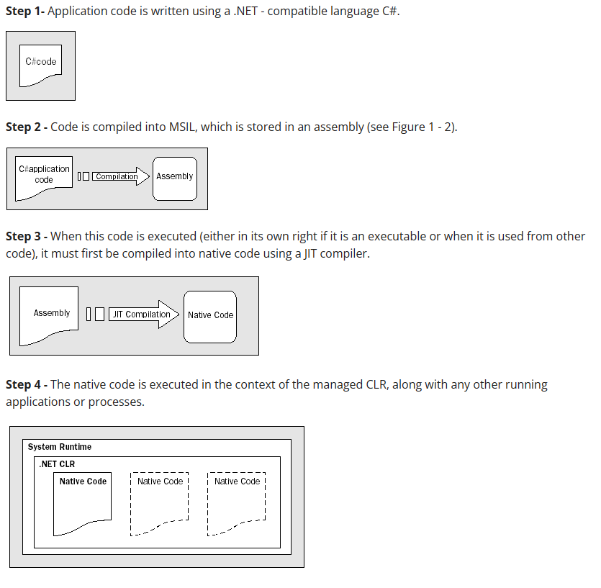
Common Language Run Time(CLR)
Garbage Collection

Slide 23
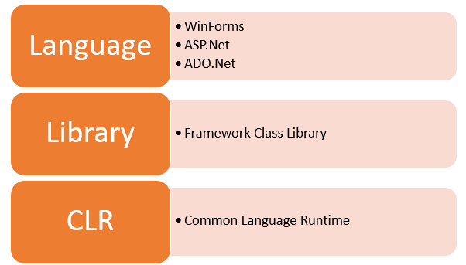
.NET Framework Components
CLR(Common Language Runtime)
CLS(Common Language Specification)
CTS(Common Type System)
BCL(Base Class Library)
FIGURE 1.4(Components)[3]

Slide 24
.NET Framework Components
CLR(Common Language Runtime)
CLS(Common Language Specification)
CTS(Common Type System)
BCL(Base Class Library)
FIGURE 1.4(Components)[3]

Slide 25

THANK YOU
For any Query:-
Email-ID:-gurpreet.e12934@cumail.in

